Slide 1
GRAIN PALLETE-A DEEP LEARNING ODYSSEY IN RICE TYPE CLASSIFICATION

Slide 2
INTRODUCTION
Project overview:
Grain Palette is a deep learning-based web application designed to classify five different varieties of rice using transfer learning with MobileNetV2. This tool aims to assist farmers in identifying rice types accurately without requiring expensive agricultural expert consultations.
purpose :
The primary objective of this project is to provide an affordable and efficient solution for rice classification.

Slide 3
IDEATION PHASE
Problem statement:
Rice classification is traditionally performed by agricultural experts, making it costly and inaccessible to many farmers. An automated system can bridge this gap by offering an instant and reliable classification tool.
Empathy map canvas:
understanding the needs, challenges, and perspectives of farmers to develop a user-friendly solution.

Slide 4
BRAINSTROAMING
Identifying potential machine learning models dataset sources, and application features to maximize usability and accuracy.
Customer journey map:
Mapping out the user interaction with the web application, from image upload to rice variety prediction.
Solution requirement:
Image-based classification of rice varieties.
Web interface using Flask.
Lightweight deep learning model (MobileNetV2) for fast predictions.

Slide 5
Data flow diagram
Illustrating the process flow from image input to rice variety prediction output.
Technology Stack:
Frontend: HTML, CSS, JavaScript
Backend: Flask (Python)
Model: MobileNetV2 (TensorFlow/Keras)
Database: SQLite (if applicable)

Slide 6
Project Design
Problem solution fit:
Ensuring the model accurately classifies rice types and is accessible to farmers via a simple web interface.
Problem solution:
Implementing a Flask-based web app that allows users to upload rice grain images and receive instant classification results.
Solution architecture:
High-level architecture diagram detailing model training, web hosting, and user interaction

Slide 7
Project Planning & Scheduling
Project Planning:
Timeline and milestones for dataset collection, model training, web development, and deployment.

Slide 8
Functional and performance testing
Performance testing:
Evaluating the model's accuracy, speed, and efficiency in classifying rice varieties.

Slide 9
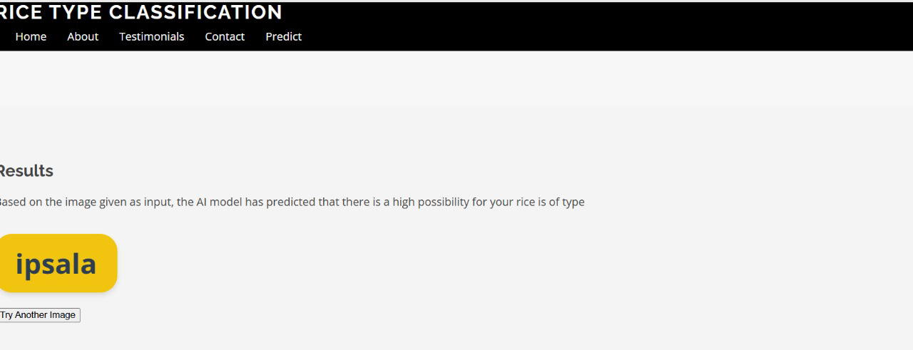
Output screenshot

Slide 10
Advantages & Disadvantages
Advantages:
Displaying the web app interface, classification results, and model performance.
Disadvantages:
Accuracy dependent on dataset quality, requires internet access.

Slide 11
Conclusion
Summarizing project achievements, challenges, and potential improvements.
Future scope:
Summarizing project achievements, challenges, and potential improvements.

Slide 12
Appendix
GitHub repository link:
https://github.com/lakshmi8817/GrainPalette-A-Deep-Learning-Odyssey-In-Rice-Type-Classification-Through-Transfer-Learning
Data set link:
Rice Image Dataset
Project demo link:
https://www.mediafire.com/file/xn8rxb70bs1dor4/InShot_20250701_171842948.mp4/file

